Slide 1

2024-2025 Rule Changes

Slide 2
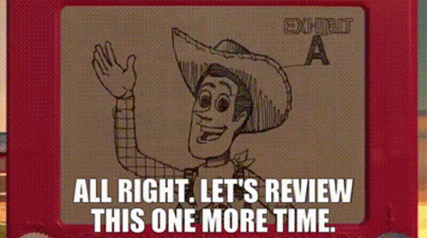
Backboards
A ball is out of bounds and becomes dead when it:
Rule 2.3H touches any part of a backboard or its supports hanging in a vertical position, over a playable area if it is served a served ball, or in the judgement of the referee, the ball would not have remained in play if the backboard had not been there.

Slide 3
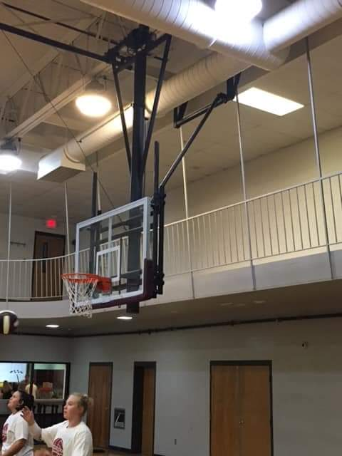
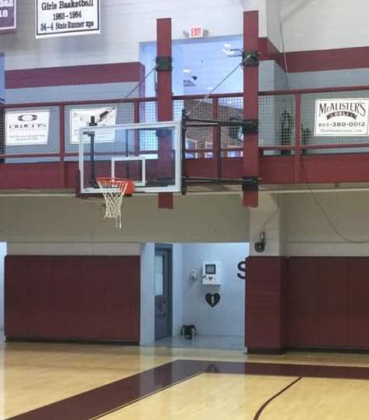
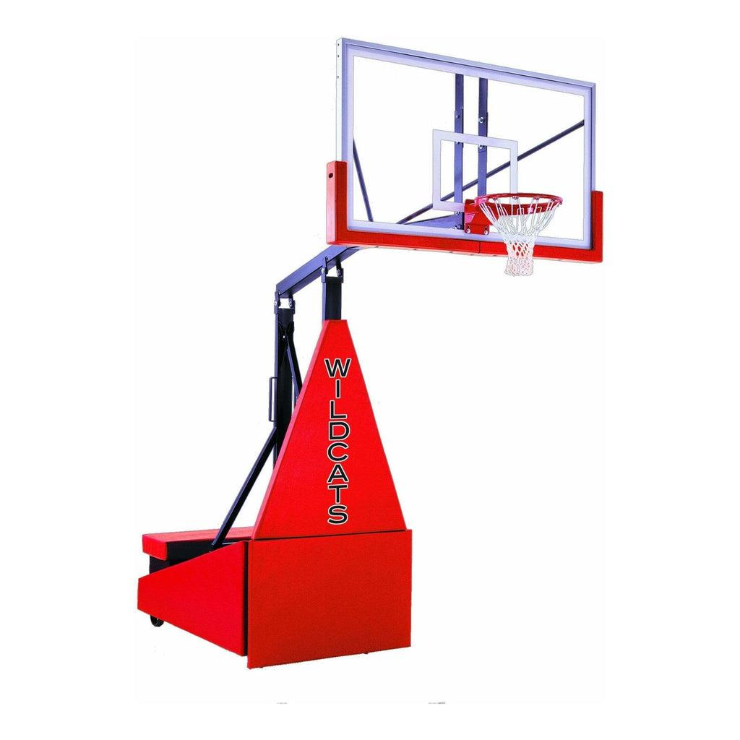
1. 2. 3.

Slide 4

TIME TO REWIND

Slide 5
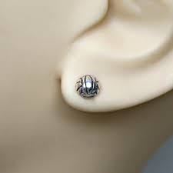
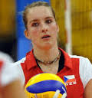

4.1.7, 4.1 Penalties 1 - Jewelry Allowance
Allows small, secured STUD or POST jewelry to be worn above the chin aligning with current trends in the sport.
YES!
NO!

Slide 6
5.5.3b(11), 12.2.6 - Assistant Coach Standing
Establishes that ONE assistant coach may stand within the coaching zone to provide instruction during dead-ball situations ONLY. The assistant coach who stands may change throughout the match, but only ONE can stand at a time.
Point of Emphasis: Once the R1 extends an arm for the authorization of serve, the assistant coach must return to the bench and may not stand again until the next dead ball.

Slide 7
2022-23 Clarification Note:
Assistant coaches shall remain seated on the bench during set except -
During a dead ball they can ask second referee to review accuracy of score, verify number of time-outs and/or number of subs used by their team, request serving order of their team, verify proper server or opponent.

Slide 8
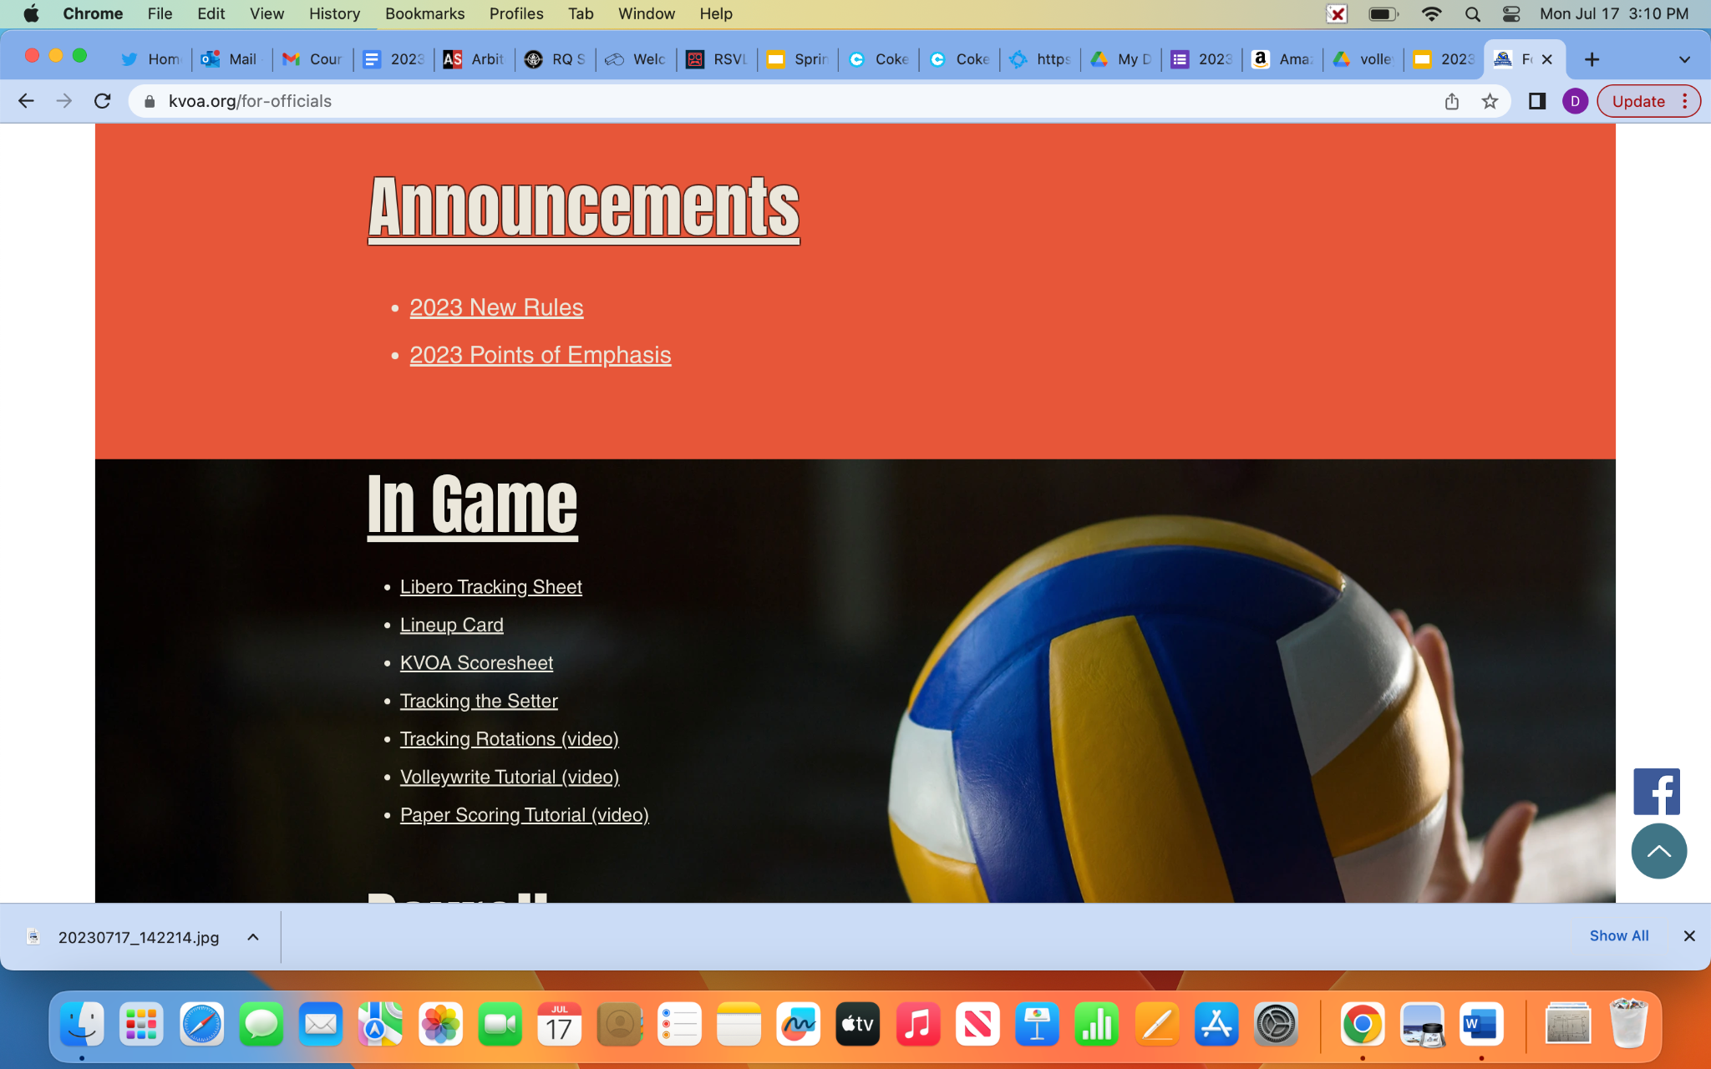
2023-24 Volleyball Points of Emphasis
Use of Lineup Card
The process of using a lineup card should not be a distraction.
The process should not hinder the tempo of the match.
Always put the card/pencil away in pocket before signaling or giving the game back to the R1.

Slide 9
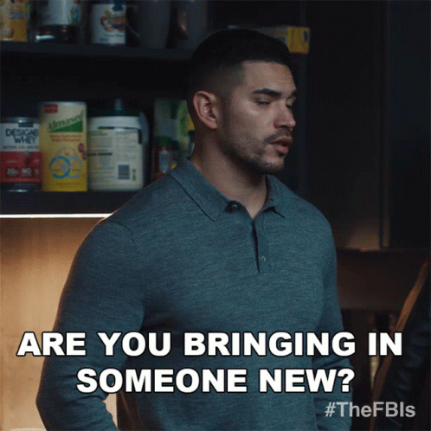
TIME FOR SOMETHING NEW!
2024-25

Slide 10
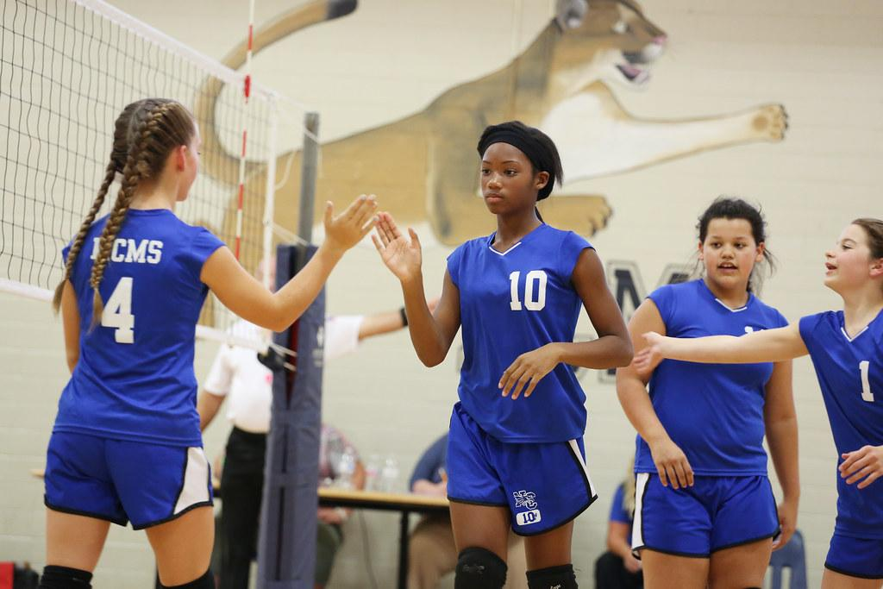
UNIFORM NUMBER CHANGE
4-2-3a, 7-1-1 NOTE: Allows a player to change uniform numbers without penalty when a uniform is damaged in addition to when a uniform has blood on it.
Rationale: Adds language to Rule 4: Uniforms regarding the proper procedure for a legal uniform number change and expands to include a damaged uniform as a legal reason for changing a uniform number. Aligns language in Rules 4 and 7.

Slide 11
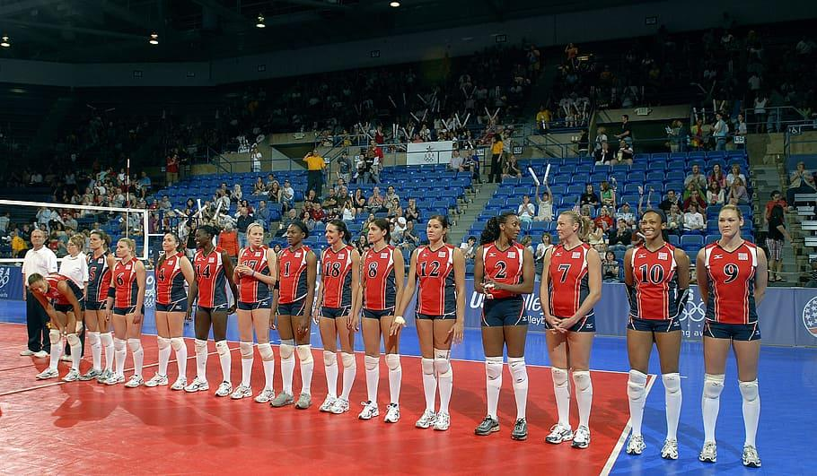
Prematch announcements
5-4-3c(1): Allows all players on the roster, not just starting players, to stand on their respective end lines prior to the first set.
Rationale: Encourages the inclusion of all players in the prematch announcements.

Slide 12
Prematch announcements Situations:
SITUATION 1: Prior to the first set, the first referee directs all players to their respective end lines for prematch announcements. Both teams send out their entire rosters.
SITUATION 2: Prior to the first set, the first referee directs all players to their respective end lines for prematch announcements. Team A sends out only its starting players and Team B sends out all its rostered players.
SITUATION 3: Prior to the first set, the first referee directs all players to their respective end lines for prematch announcements. Both teams send out only their starting players.
LEGAL!

Slide 13
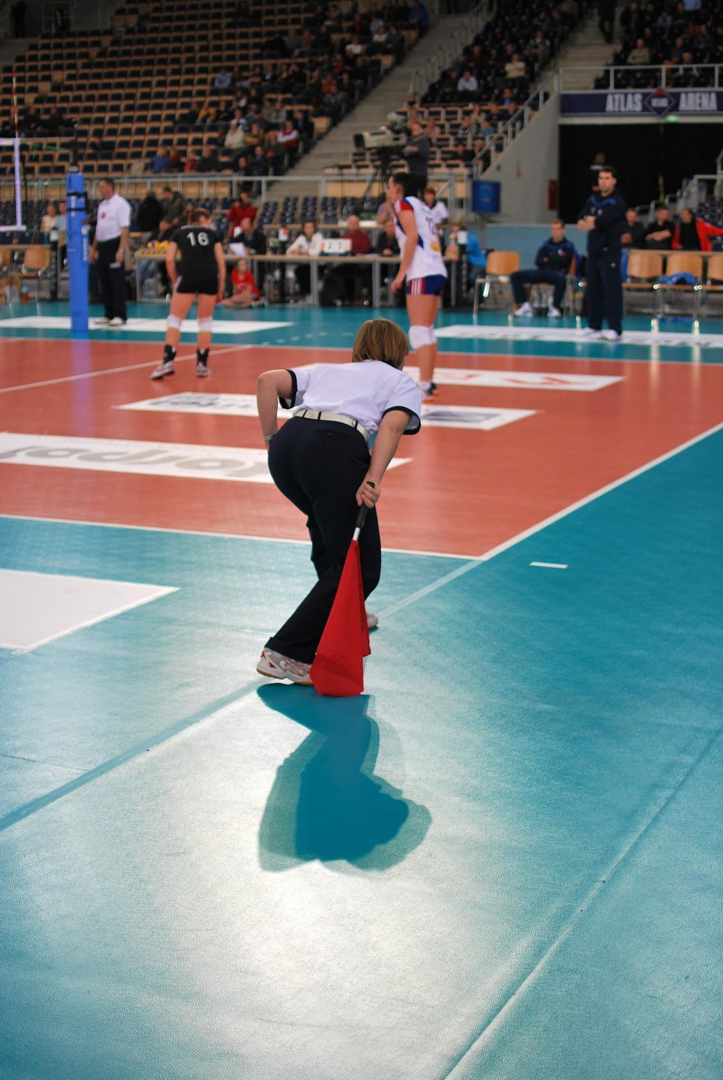
Line judges
5-9-2b NOTE (NEW), State Association Adoption Chart: Requires line judges to switch sides of the court between sets when, by state association adoption, teams remain on the same benches throughout the match.
Rationale: Aligns with the original intent of the rule allowing line judges to alternate between each set to promote fair officiating.

Slide 14
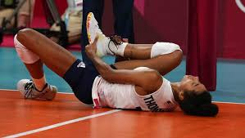
Libero replacement & injury
11-4-1b: Allows teams to substitute during an injury time-out for the libero replacement if the libero is injured or ill.
Rationale: Allows for the immediate substitution of the libero replacement who may be playing out of position due to the injury to the libero.

