Slide 1
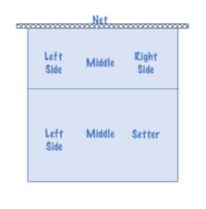
I’m Suppose to be Where?

Slide 2

Basics:
Definition: Rotational Fault
- Serving player is not in the correct rotation order (wrong server)
Definition: Position Fault
- Players not in correct positions at the moment the ball is contacted by the server
When do we whistle?
- Only after the contact of the serve
Then what? R2 must correct player positions!

Slide 3
What are Teams Trying to Accomplish?
Setter does not receive serve
Best passers take first ball
Hitters in position to transition quickly to attack
Hide a less-skilled passer

Slide 4
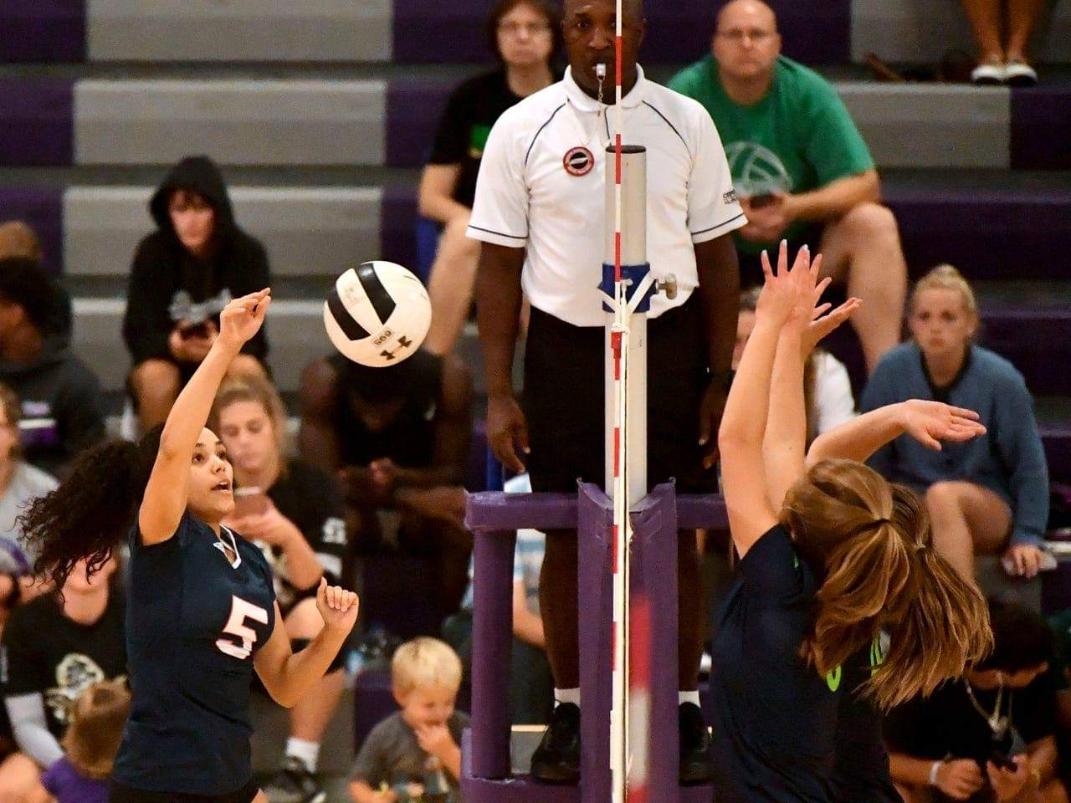
R1 Tracking Positions Checklist
Know where the setter is
More than just the serving team
Look at the front row of the serving team
What is the libero position?

Slide 5
R2 Tracking Positions Checklist
Where are the setters?
What is the position of the serving team (who is serving)?
What is the position of the receiving team?
How can the scorer help?
How can the teams help?

Slide 6

What is Your Method?

Slide 7

“Coach speak” vs Language of the rules
Coaches and students of the game reference player positions based on where the setter is.

Slide 8
Rotations are defined by the setter’s position:
Setter in right back = Rotation 1
Setter in center back = Rotation 2
Setter in left back = Rotation 3
Setter in left front = Rotation 4
Setter in center front = Rotation 5
Setter in right front = Rotation 6
6
Right
Front
5
Center
Front
4
Left
Front
1
Right
Back
2
Center
Back
3
Left
Back
N
E
T

Slide 9

Tracking Player Positions
Setter and the opposite
Does the libero lead or follow
Opposite positions
Captain as reference
Memorize numbers
Player characteristics

Slide 10
Tracking Tips
Know who leads and who follows the setter
Corners: only 2 potential overlaps; an “L”
S

Slide 11
Tracking Tips
Know who leads and who follows the setter
Middles: 3 potential overlaps; a “T”
S

Slide 12
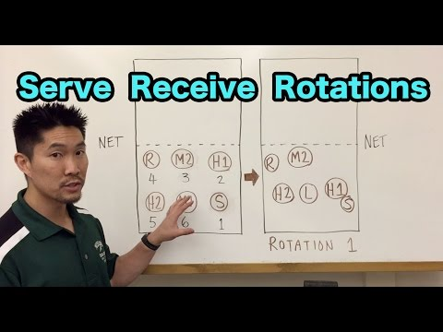

Slide 13
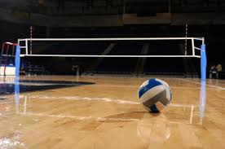
Discussion Points
When to warn?
When to call?
R1 calling overlap on receiving team?
R2 calling overlap on serving team?
R2 calls overlap, but is wrong and ball served in net or out?
Communication to coaches vs players

