Slide 1

PRE-SEASON DOs AND DON’Ts

Slide 2



DO
Contact your partner
24-48 hours before your match
Example of things to remind your partner:
Site, Time, R1/R2, Gym Location, Cold/Hot, etc.

Slide 3
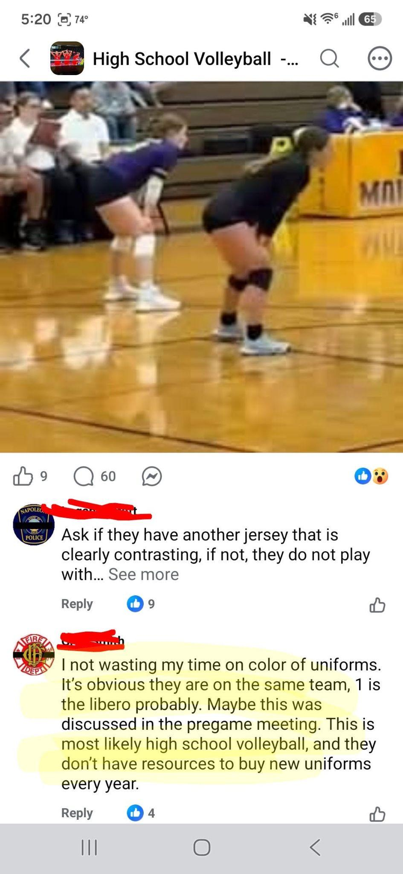
DON’T BE THIS GUY!
IS THIS A PERSON YOU WANT TO BE YOUR PARTNER?
DO YOU WANT TO BE THE OFFICIAL THAT FOLLOWS THIS PERSON?

Slide 4
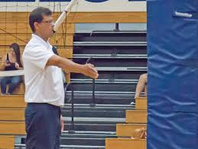
R2 BAD HABITS
DO NOT - Move to the sub’s side when administering the sub
DO NOT - Switch sides if there are subs on both sides
DO NOT - Hold the ball when checking the lineups
DO NOT - Enter the court when checking the lineups
DO - Check the receiving team first
DO - Wait to identify the captain until after the libero enters (How do you identify the captain?)

Slide 5
DO OR DON’T FOR 2 LIBEROS
A coach has 3 liberos dressed on the bench.
LEGAL OR ILLEGAL?
LEGAL!

Slide 6
DO OR DON’T FOR 2 LIBEROS
Team A lists No. 1 and No. 2 as liberos for set 1. In set 2 the coach lists No. 3 and No. 4 as liberos. The coach only lists No. 5 as the libero for set 3. Team A then lists No. 6 and No. 7 as liberos for set 4.
LEGAL OR ILLEGAL?
LEGAL!

Slide 7
DO OR DON’T FOR 2 LIBEROS
Team B list No. 20 and No. 7 as liberos.
In set 2 at 5-4, No. 7 becomes injured. The coach wants to immediately designate No. 4 as the 2nd libero.
LEGAL OR ILLEGAL?
LEGAL!
In set 4 at 3-8, No 20 is disqualified. The coach wants to immediately designate No 8. As the 2nd libero.
LEGAL OR ILLEGAL?
ILLEGAL!

Slide 8
DO OR DON’T FOR 2 LIBEROS
Team S lists No. 2 and No. 11 as the liberos. S23 is back to serve and S2 is in middle back.
S23 tosses the ball to serve, but allows the ball to drop to the floor. The R1 blow the whistle to authorize a re-serve. S11 exchanges with S2 before the R1 rebecons for serve.
LEGAL OR ILLEGAL?
ILLEGAL!
Team S calls a TO. S2 was in middle back when the TO was taken, but S11 exchanges with S2 as the team comes back to the court out of the TO.
LEGAL OR ILLEGAL?
LEGAL!

