Slide 1

2025-2026 Rule Changes

Slide 2


Slide 3
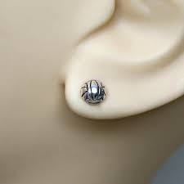
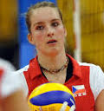
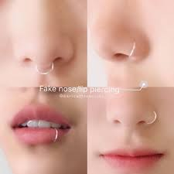
4.1.7, 4.1 Penalties 1 - Jewelry Allowance
Allows small, secured STUD or POST jewelry to be worn above the chin aligning with current trends in the sport.
YES!
NO!

Slide 4
5.5.3b(11), 12.2.6 - Assistant Coach Standing
Establishes that ONE assistant coach may stand within the coaching zone to provide instruction during dead-ball situations ONLY. The assistant coach who stands may change throughout the match, but only ONE can stand at a time.
Point of Emphasis: Once the R1 extends an arm for the authorization of serve, the assistant coach must return to the bench and may not stand again until the next dead ball.

Slide 5
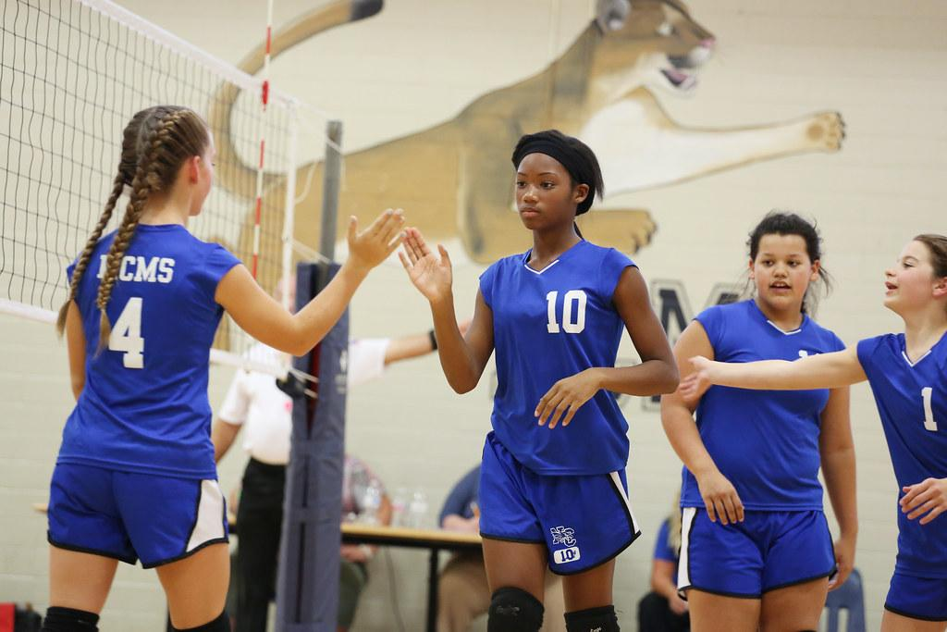
UNIFORM NUMBER CHANGE
4-2-3a, 7-1-1 NOTE: Allows a player to change uniform numbers without penalty when a uniform is damaged in addition to when a uniform has blood on it.
Rationale: Adds language to Rule 4: Uniforms regarding the proper procedure for a legal uniform number change and expands to include a damaged uniform as a legal reason for changing a uniform number. Aligns language in Rules 4 and 7.

Slide 6
Prematch announcements Situations:
SITUATION 1: Prior to the first set, the first referee directs all players to their respective end lines for prematch announcements. Both teams send out their entire rosters.
SITUATION 2: Prior to the first set, the first referee directs all players to their respective end lines for prematch announcements. Team A sends out only its starting players and Team B sends out all its rostered players.
SITUATION 3: Prior to the first set, the first referee directs all players to their respective end lines for prematch announcements. Both teams send out only their starting players.
LEGAL!

Slide 7
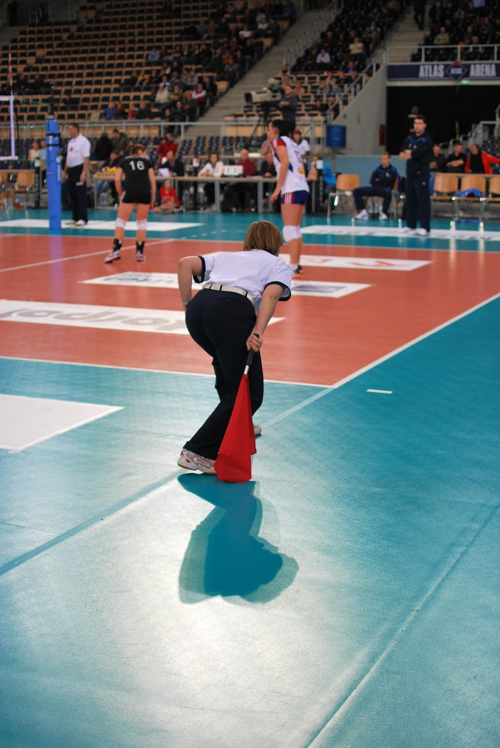
Line judges
5-9-2b NOTE (NEW), State Association Adoption Chart: Requires line judges to switch sides of the court between sets when, by state association adoption, teams remain on the same benches throughout the match.
Rationale: Aligns with the original intent of the rule allowing line judges to alternate between each set to promote fair officiating.

Slide 8


Slide 9
2025-26 Volleyball Points of Emphasis
Lineup Card
Ball Handling
First Referee Assigning Line Judges
Uniforms - Contrasting Colors

Slide 10
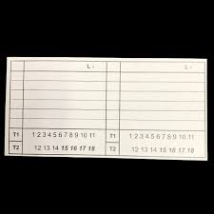
Lineup Card
5-3-2b, 5-5-3b(9): Eliminates the requirement for the second referee to carry and use a lineup card to check the starting lineups.
Rationale: Allows veteran officials to use each coach’s submitted lineup sheet to check the starting lineup while allowing the use of the lineup card as a training tool for newer officials to assist with tracking rotations during the match.

Slide 11

2. Ball Handling
9-4-8c (NEW): Eliminates the judgment call of a multiple contact fault in a single attempt to play the ball on the second team hit if the ball is next contacted by a teammate.
Rationale: Allows for play to continue when multiple contacts on the second contact does not create an advantage for the offending team.

Slide 12
Related Mechanics:
The R1 still needs to be diligent about judging multiple contacts IF the ball is contacted by the opponent 1st, not a teammate. (A double hit, with a delayed whistle.)
The R1 must be prepared to whistle a double contact IF the 2nd team contact completely crosses the plane of the net. (A double hit, with a delayed whistle.)
The R1 must continue to call any 3rd contact that is “doubled”.
The R1 will continue to allow the 1st ball double that travels over the net.

Slide 13
Double Contact Mechanics:
Setter double hits the second team contact and the ball is not touched by a teammate:
Ball crosses the net and lands out of bounds - Double Hit
Ball lands in bounds on setter’s side of the court - In
Ball lands out of bounds on setter’s side of the court - Touch
Ball crosses the net outside the antenna - Out
Ball hits an antenna- Out
Back-row setter double hits the ball while it is above the plane, and the ball completely crosses the net- BRA

Slide 14
Undergarments
4-2-1h(3), 4-2-1i(2): Team members may wear black, white or gray undergarments in addition to undergarments that match the predominant color of the uniform top/bottom under the uniform top and/or bottom. All team members, other than the libero, wearing an undergarment must wear the same color.
Rationale: Aligns with other NFHS rules codes allowing athletes to wear more commonly found colors of undergarments.

Slide 15
Illegal Libero Replacement
10-4 PENALTIES 1: Changes the penalty administration for an illegal libero replacement to an unnecessary delay if identified before contact of serve and an illegal alignment if identified after contact for serve.
Rationale: Aligns the penalty for an illegal libero replacement with the definition of illegal alignment which occurs on contact of serve.

Slide 16
POE: R1 Assigning LJS
For those states who have selected to remain on the same side of the court throughout the match, the default is for line judges to switch sides of the court between sets to allow for equitable adjudication of the lines. There may be a situation in which the first referee requires line judges to remain on the same side throughout the match. Rule 5-4-1g provides the first referee the authority to do so in order to create the best environment for match administration. First referees may make line judge position assignments based on experience of line judges, level and type of play by one or both teams, and/or observed performance. The authority of the first referee should not be used to prejudge line judges or create an unfair environment for either team. Any divergence from the default line judge positioning should be communicated with both head coaches.

Slide 17
POE: Uniforms – Contrasting Colors
The NFHS Volleyball Rules not only require the libero jersey to clearly contrast from the team jersey, but also the body of the uniform number must clearly contrast from the uniform top. These rules are in place to assist officials in easily identifying the libero as well as player numbers. When the ball and players are on the move, officials must clearly see the libero’s positioning when playing the ball as well as player numbers when watching for net, line, and attack faults. There are infinite color shades and combinations that schools around the country use which makes it very difficult to create rules defining which colors contrast with each other. It is important to emphasize the word “clearly.” The colors should be obviously contrasting from one another in all types of gym lighting when viewing from the floor and the top of the bleachers.
Tips for selecting color combinations:
• If the jersey color is dark, the color of the number should be light or even white.
• If the jersey color is light or white, the color of the number should be dark or even black.
• If the team jersey color is dark, the libero jersey color should be light or even white.
• If the team jersey color is light or white, the libero jersey color should be dark or even black.
• Avoid too many colors on the team jersey as it limits the colors for a legal libero jersey and the uniform numbers.

Slide 18

3-2-1 NOTE (NEW): Beginning with the 2026-27 school year, state associations may adopt the use of a non-smooth or textured volleyball.
Rationale: Allows either boys or girls to adopt a textured volleyball with no restrictions on color or shape of panels to be inclusive of all current textured volleyballs on the market.
4-2-4d, f: Beginning July 1, 2029, the number on the front of the uniform must be centered on the upper half of the uniform top eliminating the measurement requirements from the shoulder seam and neckline.
Rationale: Removes officials from the position of measuring uniforms to verify the legal distance of the number from the shoulder or neckline, creates consistency in number placement, and allows for number placement variances due to player body types.

