Slide 1

2023-2024 Rule Changes

Slide 2

2022-2023 Rule Changes

Slide 3
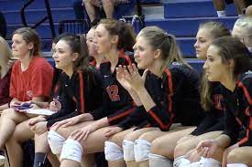
NO SWITCHING BENCHES!
By TSSAA state association rules teams will not switch benches unless there is a distinct advantage.

Slide 4
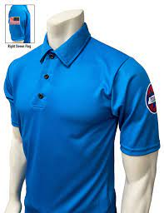
New TSSAA Shirt:
https://officiallydalco.com/collections/state-associations/tennessee?page=2

Slide 5

3-1-3 PENALTY, 4-2 PENALTY 3:
Adds language allowing state associations to determine the appropriate action/penalty when padding requirements are not met and a team does not have six legal uniforms.
Rationale: Clarifies that state associations have the authority to determine the action and/or penalty(s), if necessary, to address these issues.

Slide 6
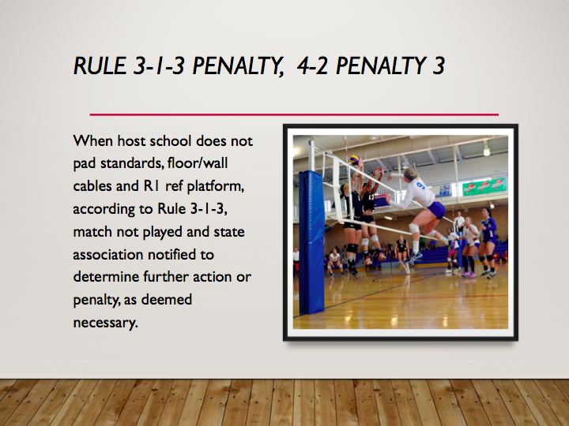

Slide 7
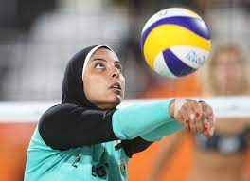

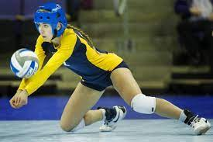
4.1.6 Clarification Notes:
Allows the wearing of religious headwear during competition that fits securely and is made of non-abrasive of soft materials. Allows hair adornments provided they are securely fastened and do not present a safety hazard while eliminating the length limitation of 2 inches for bobby pins, flat clips and flat barrettes.
Rationale: Creates inclusivity of hair styles while maintaining that the risk of injury to the athlete, teammates and opponents should not be compromised.
Head coverings worn for MEDICAL reasons require state association
approval.

Slide 8

4-2-1f:
Eliminates the manufacturer logo/trademark/reference restrictions on the waistband ONLY of the uniform bottom.
Rationale: Allows for multiple and eliminates size restrictions of manufacturer logos/trademarks/references on the uniform waistband ONLY, minimizing issues related to illegal uniform bottoms.

Slide 9

5-6-3b, e; 5-7-3e:
Eliminates the sounding of the audio device when an improper server or an illegal libero replacement is recognized by the official’s table and establishes that the official scorer shall notify the second referee during the first dead ball.
Rationale: Allows the match to continue without interruption until the second referee is notified and can verify the improper server/illegal replacement during the next dead ball.

Slide 10
7-1-2c (NEW):
Requires the head coach to indicate the playing captain with a “C” next to the player’s number on the lineup.
Rationale: Aligns language in the Case Book and Officials Manual that requires playing captains to be indicated on the lineup.

Slide 11

11-2-1:
Allows requests for time-outs by the head coach or playing captain to be signaled or verbalized.
Rationale: Establishes that both verbal and non-verbal signals for a time-out are permitted.

Slide 12

2023-2024 Rule Changes

Slide 13
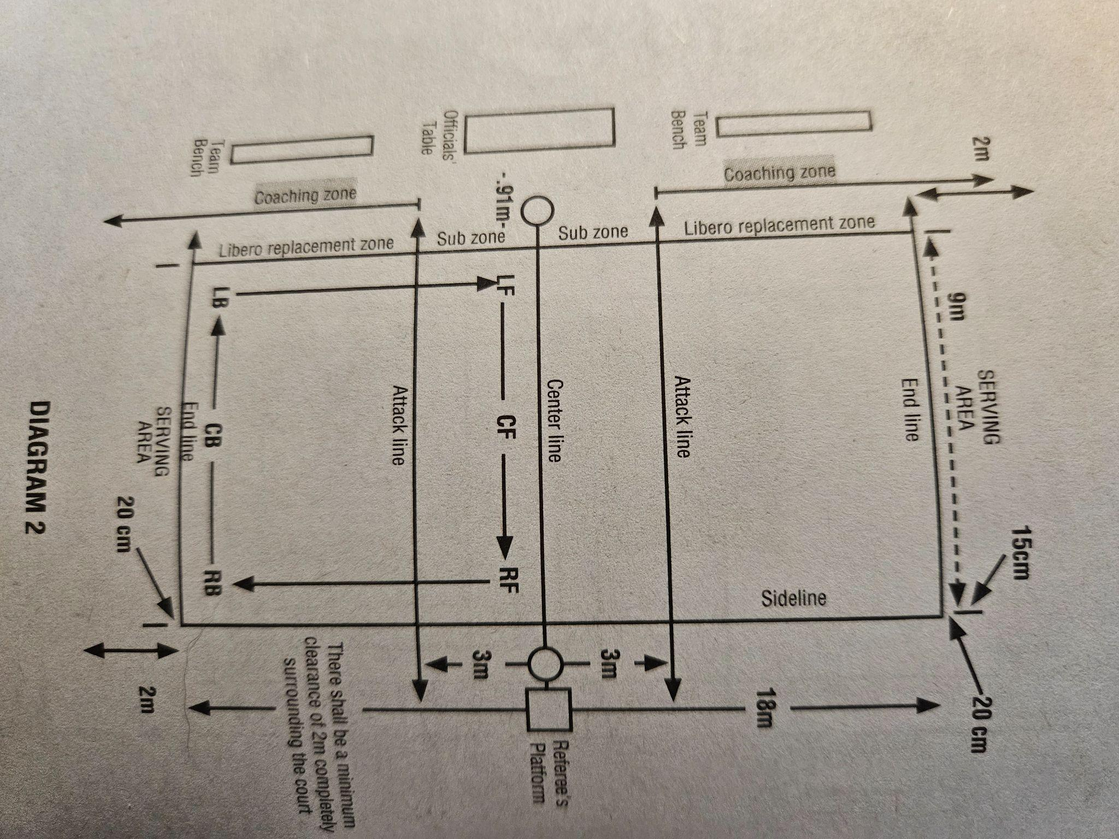
2.1.9, 12.2.5 - Coaching Zone
Creates a coaching zone defined by the libero replacement zone extending beyond the end line and sideline extended clarifying the area in which coaches can stand.

Slide 14
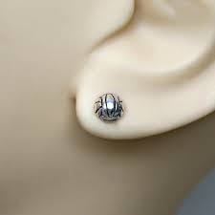
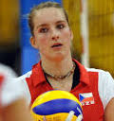

4.1.7, 4.1 Penalties 1 - Jewelry Allowance
Allows small, secured STUD or POST jewelry to be worn above the chin aligning with current trends in the sport.

Slide 15
5.5.3b(11), 12.2.6 - Assistant Coach Standing
Establishes that ONE assistant coach may stand within the coaching zone to provide instruction during dead-ball situations ONLY. The assistant coach who stands may change throughout the match, but only ONE can stand at a time.
Point of Emphasis: Once the R1 extends an arm for the authorization of serve, the assistant coach must return to the bench and may not stand again until the next dead ball.

Slide 16
2022-23 Clarification Note:
Assistant coaches shall remain seated on the bench during set except -
During a dead ball they can ask second referee to review accuracy of score, verify number of time-outs and/or number of subs used by their team, request serving order of their team, verify proper server or opponent.

Slide 17

WHY YOU READ YOUR RULEBOOK!!!
R2 Time-out Mechanics:
The second referee informs a coach of the number of time-outs used by showing the time-out signal, followed by the number of time-outs used, and then gives the ready-to-play signal to the first referee. (p.79 Casebook)
Curtain:
2.3a (Rulebook) 2.4.2 Situation C (p.10 in Casebook)
The referees should address that the curtain is restricted and functions as a wall when reviewing the ground rules.

Slide 18
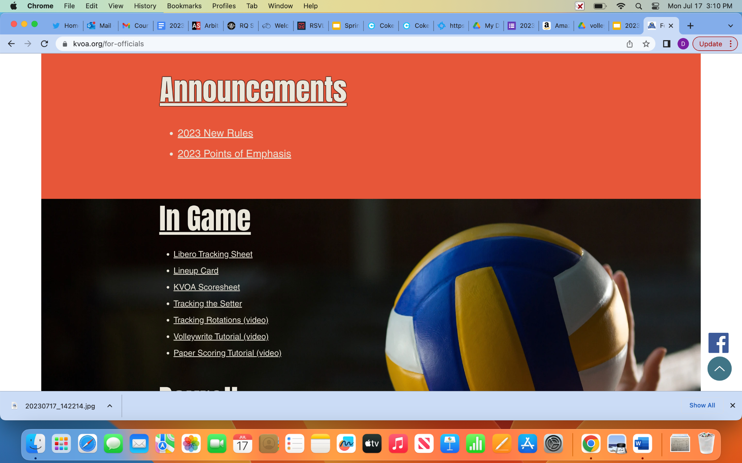
2023-24 Volleyball Points of Emphasis
Use of Lineup Card
The process of using a lineup card should not be a distraction.
The process should not hinder the tempo of the match.
Always put the card/pencil away in pocket before signaling or giving the game back to the R1.

