Slide 1

NO TUNNEL VISION

Slide 2
WHAT IS THE MOST COMMON PROBLEM FOR R2?
Some might say coaches chewing them out about questionable decisions or missed calls by the crew.
A better guess would be tunnel vision.

Slide 3
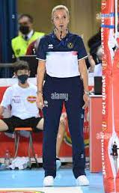
TUNNEL VISION
When second referees glue their eyes to the net during rallies, hoping to catch a net or centerline violation, they can lose sight of other things happening on the court.
Focusing on the net isn’t a second referee’s only responsibility.
The second referee should also be aware of playing actions and faults away from the net.

Slide 4

Is the R2 a Spectator?
Open up that vision. Spectators have the best view in the house. They see the entire court and all the action. Second referees are not spectators, but they need to open up their field of vision to do their job right.

Slide 5
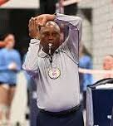
What are the R2 Duties?
The second referee has many duties, among other things:
helping the first referee with four team contacts
illegal attacks or blocks by back-row players
assisting with touches
libero playing actions
failed pancake attempts
plays that may have been screened from the first referee.
That’s more reason to tune in on the action instead of concentrating only on the net and centerline.

Slide 6
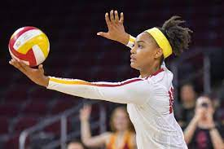
Before the Serve?
Before each serve, don’t lock in on the net.
Scan the entire formation of the serving and receiving team for overlaps.
Know who the server is.
As play develops, there’s no need to pay attention to the net and centerline until the ball enters that vicinity.
Then be on the blocking team’s side of the net and focus on the area of the net where the ball crosses.***

Slide 7
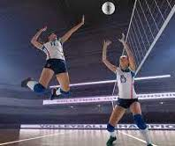
During the Attack?
As the attack unfolds, watch the play, not the net.
Once the attacker is identified and feet placement in relation to the attack line is noted, or when a player might contact the net while playing the ball, that’s the proper time to shift our second referee eyes to the net and centerline.
Focus on the blockers without ignoring the offensive players. Don’t follow the ball as it crosses beyond the blockers. Keep those eyes front and center until no player at the net can commit a fault.

Slide 8
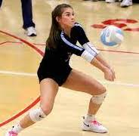
When Does the R2 Transition?
When do you see first team contact?
When all is clear, track down the ball quickly while transitioning sideways with a purpose to the blockers’ side with a direction step and then a crossover step, but not a Sunday stroll.
Be in position before the second team contact and start all over again with a broad view to observe the entire playing action develop.

Slide 9
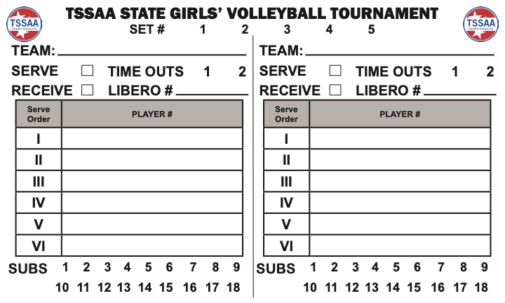
R2 & the Line-Up Card!
Rule 5-3-2b is not new. The requirement of the R2 to have a lineup “card” has been required for years. What they do with that card is where the recommendations come in. This was the purpose of the POE – to both remind officials that the lineup card is a required tool and to provide different ways in which the lineup card can be used.
The lineup card is a tool to assist the second referee and is used to record starting lineups and verify each team's lineup at the start of each set (Requirement reminder).
The second referee can also use the lineup card to:
1. Record Substitutions;
2. Record time-outs used by each team;
3. Identify players (circle the back-row setter); and/or
4. Record Yellow/Red Cards (Recommendations).

