Slide 1
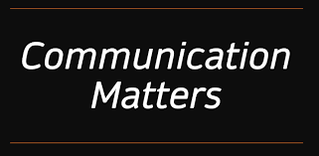

Slide 2

Officials communicate with coaches to:
To ensure a smooth and fair game
Manage potential conflicts
Build positive relationships

Slide 3
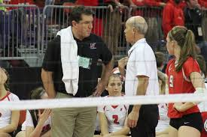
Effective Communication Involves:
Setting clear expectations
Using respectful language (the Golden Rule)
Active listening
Provides clear and concise explanations
Non-verbal communication

Slide 4

Pre-game Meeting:
Professional Demeanor - confident presence, clean uniform, and professional
Brief Meeting - outline expectations, procedures, address any concerns
Conversations - concise and professional, avoid lengthy conversations and controversial statements

Slide 5
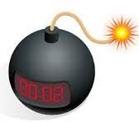

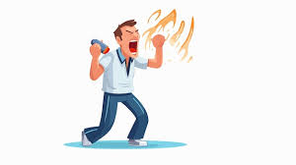
7 Steps of Better Communication
Know the Situation - use your words to defuse the bomb the coach may be ready to detonate. It’s not coach v official.
Don’t React; Just Respond - “speak when spoken to”, a response is a response and not a reaction, “Coach, I hear you.”
Be Authentic - it’s okay to be human.
Coaching Motives - Influencing? Testing? Friendly? We do not respond to a coach after every whistle. Listen first; respond second.
A Cyclical Trend - Minimize conversations. Be available, but every play does not deserve and explanation.
Anticipate - What rules or rule changes are you going to have to handle this year. What might the coach need? See the bench.
Actions Speak Louder - Know the rules! Know the mechanics! Know your positioning!

Slide 6

Communication Strategies
Use short, rules-based answers and ask questions
Acknowledge the coach's point of view
Avoid having the last word
Be aware of non-verbal communication
Know the rules and be prepared to explain them
Be prepared to work with different personalities and anticipate various scenarios
Focus on building community and connecting with coaches
Use “We” terms

