Slide 1
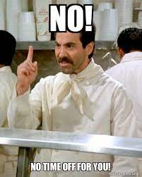
NO TIME OFF!

Slide 2

No Time Off!
What is going through the minds of officials as they prepare for the next play?
Tips for officials between the time a point is awarded and the beckoning for the next serve.

Slide 3
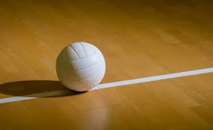
Watch for any unsportsmanlike actions
The majority of points in a volleyball match are not controversial. However, there are several plays in which unsportsmanlike behavior might follow.
Big Block or Kill
Coach or Player feels like there was a missed touch
Close line call
Ball handling call that went against their team
After awarding the point, the officials needs to observe players and coaches for unsportsmanlike actions toward the other team or the officials. Either official may need to provide a verbal warning or the first referee use cards to handle the situation.

Slide 4
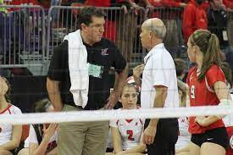
2. Scan the benches for substitutes or timeouts
After awarding the point and observing the general behavior of the teams, the R1 should conduct a visual scan of each team’s bench.
The first part of the scan is observing the benches for any:
Substitutions
Libero Replacements
Timeouts
The R2 initiates, but it is important the R1 scans as well in case the R2 is preoccupied answering a coach’s question or talking to the score table and misses the request.

Slide 5
3. The scan for beckoning for serve
SCAN, SCAN, AND SCAN SOME MORE!
Starting with the receiving team, the R1 should scan the court including looking at the LJs and players of the receiving team on both the court and the bench. The R1 needs to ensure all players are ready to play and are in the correct position.
After reviewing the receiving team, the R1 will quickly observe the scorer’s table and the R2 to make sure they are ready for play.
The last part is scanning the serving team. The R1 needs to confirm the server has the ball and take a quick rescan at the R2 before beckoning for the serve.
These scans are important to identify any potential risks for injury, such as untied shoes, safety issues, and to look for general alignment of players.

Slide 6

3. The scan - “side bar”
Although scanning the whole court and both team benches may seem like it will take a long time, the process only takes a couple of seconds.
Strive to keep the pace of the players.
Coaches/Players can get frustrated when the server is ready to serve and the R1 is slow to beckon for service.
The majority of the time, referees can conduct their scan and beckon for service without a delay.
During the scan, officials should make a mental note of the setter’s location and identify the back-row players. For officials who quickly learn the rotation, this process can happen smoothly.

Slide 7
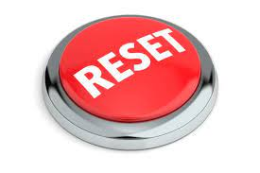
4. When there is extra time
When there is a substitute or if the ball rolls a long way, the R1 has extra time between points.
Take the whistle out of your mouth.
This is a good time to slow down the scan and observe any behaviors or situations that may need to be addressed immediately or more likely during a timeout or end of set.
Examples of these might include substitutes/assistant coaches creeping too close to the playing court, items being on the playing area that may interfere, or phones/extra people being at the scorer’s table.
Mental reset
Relaxation breathing
Positive self-talk

